Slide 1

The Battle of neighborhoods - Toronto

Slide 2
1. Description of the problem Cynthia would like to open a new clothing store in the city of Toronto. More specifically, she is interested in the area of downtown Toronto, so she wants to explore where are located the already existing stores so as to decide accordingly.
- Neil Armstrong

Slide 3
2. Description of the Data The data that will be used are: Toronto neighborhood data:\ The following wikipedia page (https://en.wikipedia.org/wiki/List_of_postal_codes_of_Canada:_M) will be used to pull information such as postal codes, boroughs and neighborhoods of Canada. Venues in Toronto:\ Foursquare API will help us to get venues by category, location and the relevant business names.
- Neil Armstrong

Slide 4
3. Methodology - Data cleaning and analysis of the data provided by Wikipedia and Foursquare - K-Means clustering to identify location groups of clothing stores
- Neil Armstrong

Slide 5
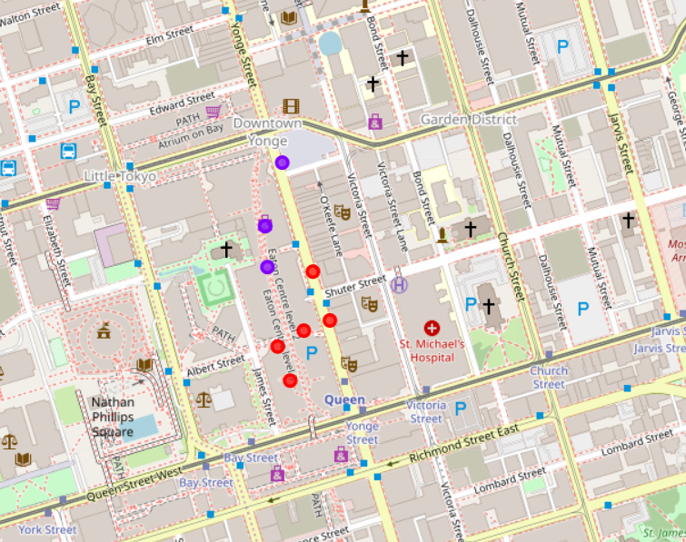
4. Results
Downtown Toronto clothing stores are located in a specific area close to each other
Can be separated into 2 groups

Slide 6
5. Conclusions Cynthia can open her new clothing store downtown Toronto near one of the 2 existing group of stores
- Neil Armstrong

